Slide 1
Azure Tenant Optimization Agent

Slide 2
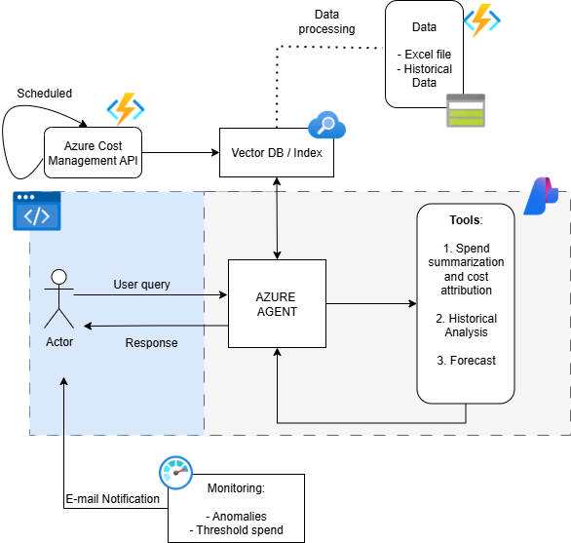
Architecture Draft 1

Slide 3
Agent
An Azure AI agent that can identify which tool to call based on user query.
Agent must be connected to vector database

Slide 4
Tools
Spend summarization and cost related questions. It can just answer questions or return table format responses. (Should we add report generation ?? )
A tool for perform historical analysis, get insights, etc.,
A tool for perform forecasting… it can call a pre built forecasting model. Try LLM for forecasting and compare.

Slide 5
Data
Excel files (Luz)
Historical data
Get metadata from azure tenant, RGs, services etc., with powershell (Authenticating with SP or MI)
Can we get the sevice usage from Azure ?
Create azure AI Search index with these fields: Tenant, subscription id, RG name, resources [list], monthly cost, average cost ??, historical data, owner, users, Project,
Automatically update index with azure function, logic app ?

Slide 6
Monitor
Try to use Azure Monitor and alerts
No need to implement Agents for this.
Configure Alerts and notification system

Slide 7
Feedback Loop
The UI must have a field for the user to capture comments about the response, like or dislike, and we need to store all that information in a separate table or index.

Slide 8
Questions
Los archivos de Excel llegan cada cuanto ? Siempre tienen el mismo formato ?? Columnas, rows.
Los datos históricos hasta donde llegan ? Son por RG, por tenant ?
Que restricciones tenemos en cuanto a accesos o permisos en el tenant ?

